Slide 1
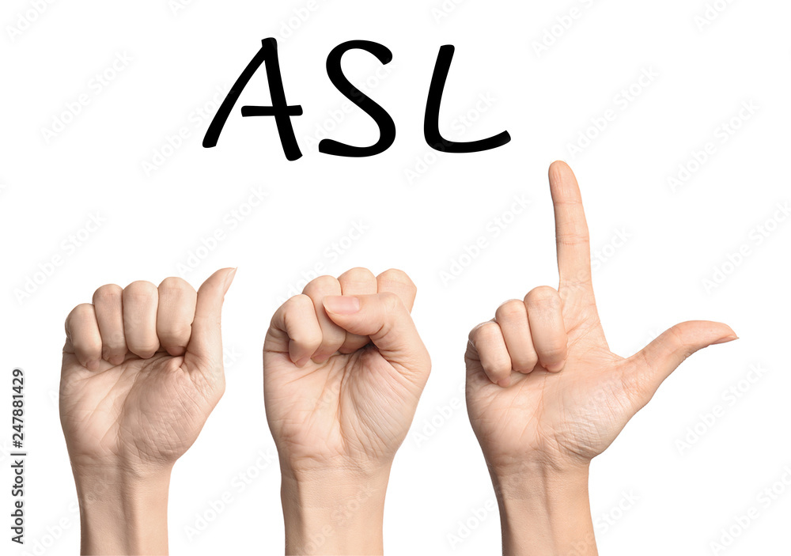

Presented By
Presentation on:
Sign Language Recognition using Machine Learning
Mahmuda Rahman mou
Id: 20201080010
Chandan Bhowmick
Id: 20201102010
MD. Muijur Rahman Al Amin
Id: 20201097010

Slide 2
OVERVIEW OF THIS PRESENTATION
Introduction
Background
Motivation
OBJECTIVES
Methodology
Evaluation and RESULTS
Comparison
Conclusion
References

Slide 3
Introduction
Sign language recognition aims to bridge the communication gap for hearing or speaking disabilities by utilizing advanced deep learning techniques and computer vision technology. Techniques like convolutional neural networks (CNNs) and hidden Markov models are used to enhance accuracy and speed in identifying sign movements. This innovative approach automates feature construction, improving accuracy and generalization, ultimately enhancing accessibility for individuals with hearing or speech issues.

Slide 4
Background
Researchers in sign language recognition are focusing on improving precision and speed through advanced deep learning and computer vision.
Ongoing research explores various approaches, including CNNs, hidden Markov models, and complex deep learning architectures.
Successful training and assessment of deep learning models involve the introduction of new datasets and evaluation metrics.
Integration of 3D pose estimation networks and synthetic datasets enhances accuracy in recognizing sign language gestures from RGB images.

Slide 5
Background (Cont.)
Extensive datasets such as WLASL are crucial for developing and assessing deep learning models at a word level.
Applying appearance-based and posed-based models for experimentation seeks to overcome complex variations in the detection of sign language.
Incorporating visual alignment restrictions into uninterrupted networks improves feature extraction and alignment supervision.
The research community focuses on implementing inventive deep-learning structures and multimodal methods for progress in sign language recognition.

Slide 6
Motivation
Bridging Communication Gaps: Facilitates communication between individuals with hearing or speech impairments.
Overcoming Complexity: Development of accurate and efficient recognition systems is prompted by the difficulties associated with the complex hand motion detection of sign language.
Advancing Recognition Technology: Explores deep learning techniques for improved feature extraction and temporal modeling.
Enhancing Performance: Integrates visual alignment constraints for enhanced feature extraction and supervision.

Slide 7
objectives
To Develop a network for hand pose estimation using RGB images, focusing on 2D keypoint detection and 3D pose estimation, aiming for good performance in sign language recognition applications.
To Propose a deep learning method for enhancing performance in hand shape recognition and continuous sign language recognition without explicit alignment.
To Present a learning-based system is being developed to accurately estimate 3D hand poses from real-world photos, enhancing gesture and sign language recognition capabilities.
To develop a framework, Convolutional networks that are utilized in sign recognition, enhancing accuracy by extracting features from various modalities and combining them for multimodal recognition.

Slide 8
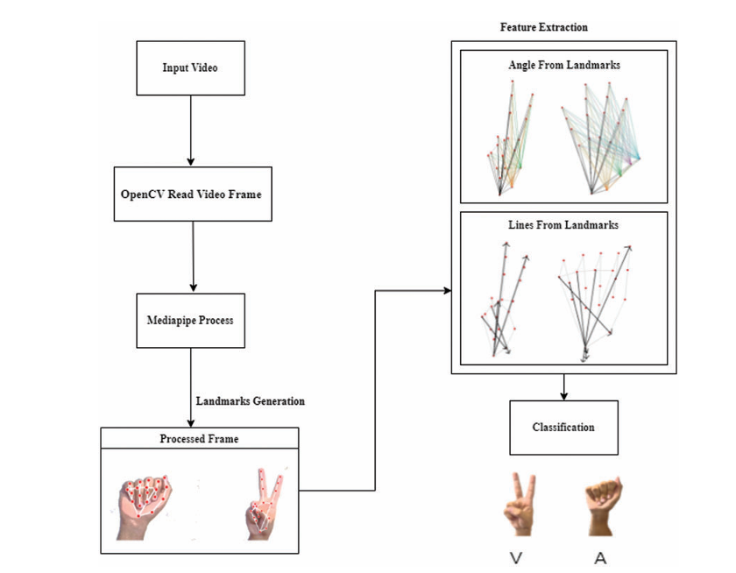
METHODOLOGY
Figure : Workflow

Slide 9
METHODOLOGY (Cont.)
OpenCV Video Frame
The OpenCV library has been used to read the dataset image frames. The ASL-alphabet(American Sign Language) datasets has been selected for this work. A camera has been used to record hand gestures and the obtained videos have been converted into image frames. The frames have been passed through a pre-processing phase using open computer vision library which reads the video frame by frame

Slide 10
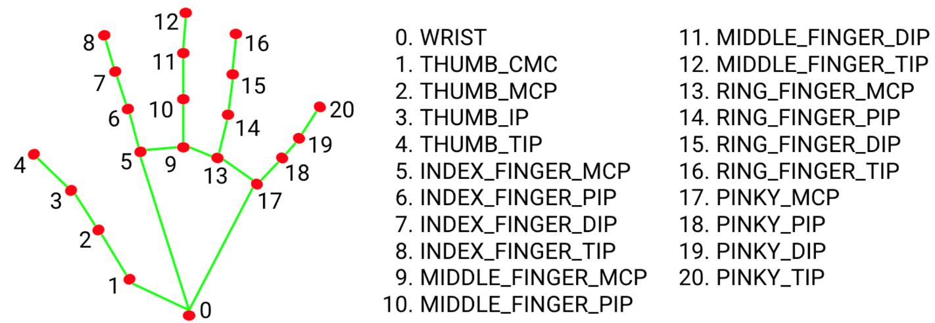
METHODOLOGY (Cont.)
Hand Landmark:
The Hand Landmark model detects 21 3D keypoints on a hand, including the fingertips, knuckles, and the base of the hand. These keypoints provide spatial information about the hand's pose, which can be used to infer gestures, hand poses, and movements.These landmarks serve as essential features for subsequent stages of the sign language recognition model.
Figure :MediaPipe Hand Landmark

Slide 11
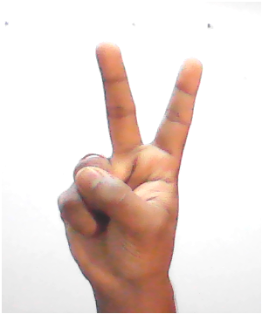
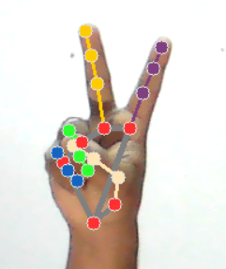
METHODOLOGY (Cont.)
Mediapipe Graphs:
Mediapipe graphs serve as the backbone of the Mediapipe framework. Mediapipe processes data through a series of interconnected nodes within its graphs.. Every time a graph runs, the Framework implements Open, Process, and Close methods in the calculators. Open initiates the calculator; the process repeatedly runs when a packet enters. The process is closed after an entire graph run
Figure :MediaPipe Data

Slide 12
METHODOLOGY (Cont.)
* Training Step :
For training we used LSTM model using our dataset. All the 26 alphabet gestures are collected one after the other and are preprocessed into numpy arrays and stored. The dataset collected is then passed onto the LSTM model. The LSTM model will have all the 26 alphabet classes for each of the alphabets. The algorithm is made to run on 500 epochs until the accuracy becomes closer to 1 and training loss goes to nearly 0. The algorithm runs with the above specified features and generates the model which is stored for future use. The model can now be used for tracking the live hand gestures and for further operations

Slide 13
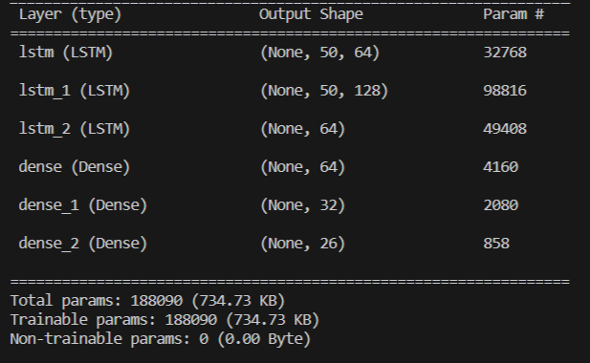
METHODOLOGY (Cont.)
Train History
In Picture we can find the summary of the model with the layer type , output shape and params.. The model that we are using is sequential and they are faster to train and have faster detections. The network implemented here consists of six layers three LSTM layers and three dense layers

Slide 14
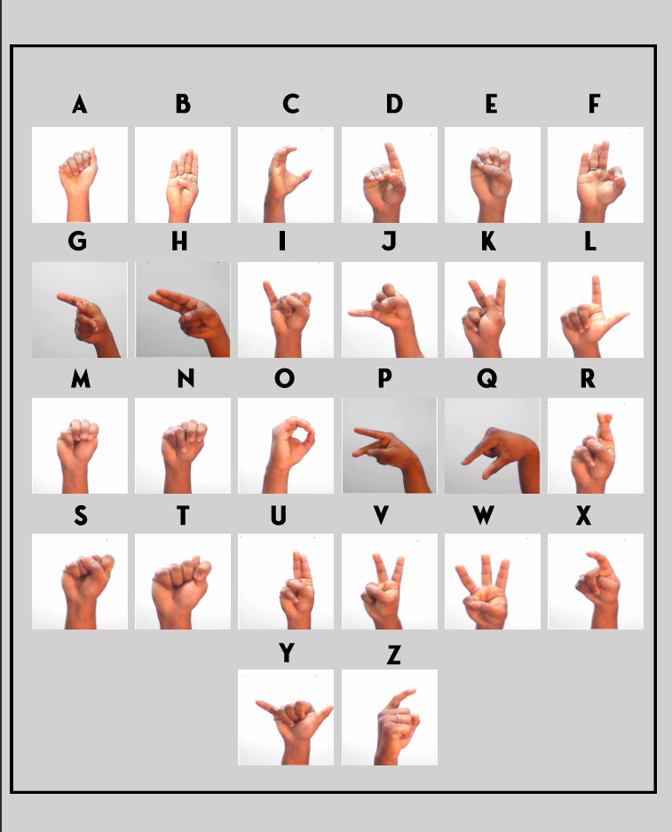
EVOLUTION AND RESULTS (Cont.)
Figure: A to Z Sign Language DataSet

Slide 15
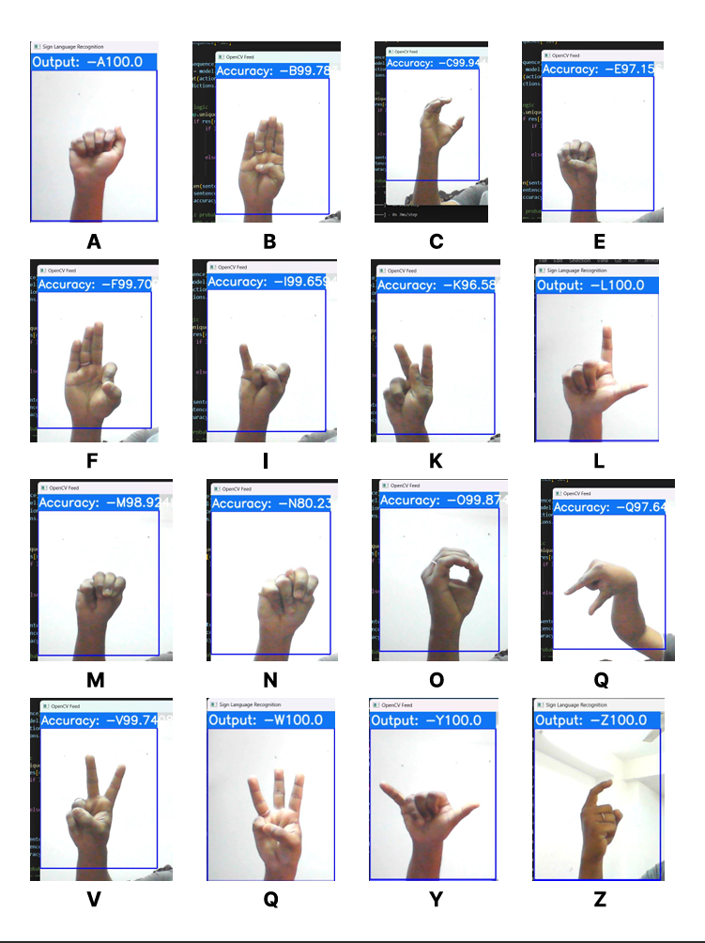
EVOLUTION AND RESULTS (Cont.)
Figure: Tested Data

Slide 16
EVOLUTION AND RESULTS
Figure: Accuracy comparison among the epochs

Slide 17
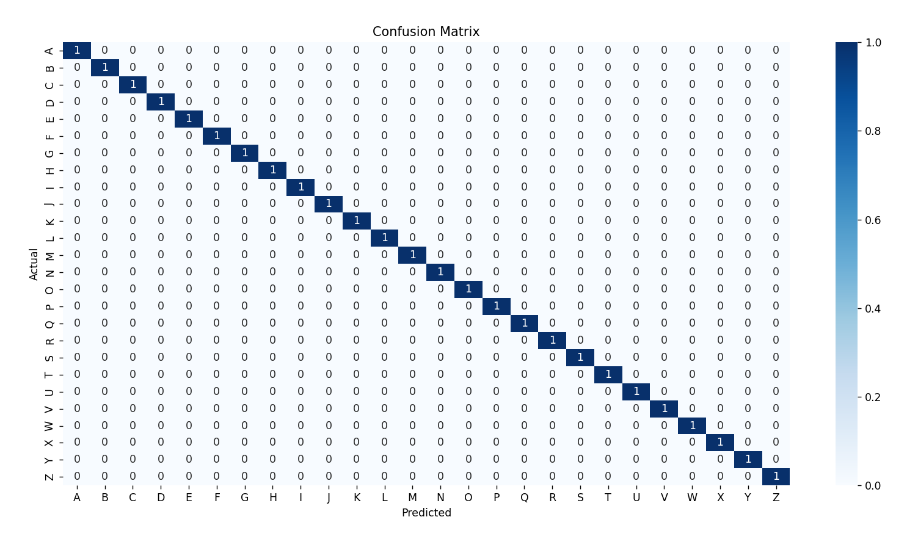
EVOLUTION AND RESULTS (Cont.)
Achieved test accuracy of 99.99 % on test data
Figure: Confusion Matrix

Slide 18
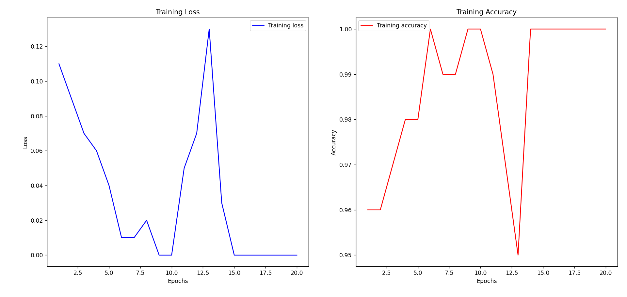
EVOLUTION AND RESULTS (Cont.)
Figure: Accuracy Graph

Slide 19
Comparison
Authors | Datasets | Accuracy Rate
Hussain, Muhammad Jamil, et al. [5] | American Sign Language (ASL) | 93.70%
Kadhim, R. A., & Khamees, M. [6] | American Sign Language (ASL) | 98.84%
Taskiran, M., Killioglu, M., & Kahraman, N. [7] | American Sign Language (ASL) | 98.05%
Kavana, K. M., & Suma, N. R. [8] | American Sign Language (ASL) | 99.50%
 | Indian Sign Language | 99.92%
 | Italian Sign Language | 98.19%
Rajasekhar, N., e [9] | American Sign Language (ASL) | 99.99%
Kumar, R., Bajpai, A., & Sinha, A. [10] | American Sign Language (ASL) | 99.95%
Our approach | American Sign Language (ASL) | 99.99%

Slide 20
Comparison (Cont.)
Figure: An accuracy comparison between Our Approach and Others Approach

Slide 21
Comparison (Cont.)
Figure: Accuracy comparison chart on the same dataset

Slide 22
Conclusion
Classification and recognition method for Sign Language using MediaPipe's model architecture along with LSTM.
Flexibility in optimization, allowing customization of the model as per target requirements.
Superior precision compared to traditional shallow structure machine learning methods.
Outperforms other deep learning architectures in image processing and big data tasks.
Achieved 99.99% accuracy on the test set, validating the efficacy of the method.Highlights exceptional precision and effectiveness of the MediaPipe and LSTM model, especially in identifying subtle indications of illness in sign language.

Slide 23
Limitations
For better performance and lifespan, more data integration is essential.
The model works well in good lighting conditions.
Plain background is needed for the model to detect with good accuracy.
We have some misrecognized problem. Some characters have similar gestures. So, it’s difficult to identify the gestures correctly.

Slide 24
FUTURE WORKS
Utilize large datasets and advanced methodologies to elevate accuracy in Sign Language Recognition (SLR) research.
We are planning to achieve higher accuracy even in case of complex backgrounds by trying out various background subtraction algorithms.
We are also thinking of improving the preprocessing to predict gestures in low light conditions with a higher accuracy.
Develop a Web Application for real-time interpretation of Sign Language gestures, promoting inclusivity across communities.- Study Transfer Learning models for enhanced detection capability in classifying various types of sign language gestures

Slide 25
References
[1] | M. M. Zaki, S. I. Shaheen, “Sign language recognition using a combination of new vision based features, ” Pattern Recognition Letters, vol. 32, pp. 572–577, 2011.
[2] | C. Chuan, E. Regina, C. Guardino, “American Sign Language Recognition Using Leap Motion Sensor,” in Proc. 13th International Conference on Machine Learning and Applications (ICMLA), Detroit, USA, 2014, pp. 541–544.
[3] | Priyanka C Pankajakshan, Thilagavathi B, Sign Language Recognition System, IEEE Sponsored 2nd International Conference on Innovations in Information Embedded and Communication Systems ICIIECS15
[4] | Jobin Francis and Anoop B K. Article: Significance of Hand Gesture Recognition Systems in Vehicular Automation-A Survey. International Journal of Computer Applications 99(7):50-55, August 2014.
[5] | Hussain, Muhammad Jamil, et al. "Intelligent sign language recognition system for e-learning context." (2022).
[6] | Kadhim, Rasha Amer, and Muntadher Khamees. "A Real-Time American Sign Language Recognition System using Convolutional Neural Network for Real Datasets." Tem Journal 9.3 (2020).

Slide 26
References (CONT.)
[7] | Taskiran, Murat, Mehmet Killioglu, and Nihan Kahraman. "A real-time system for recognition of American sign language by using deep learning." 2018 41st international conference on telecommunications and signal processing (TSP). IEEE, 2018.
[8] | Kumar, R., Bajpai, A., & Sinha, A. (2023). Mediapipe and cnns for real-time asl gesture recognition. arXiv preprint arXiv:2305.05296.
[9] | Kavana, K. M., & Suma, N. R. (2022). Recognization of hand gestures using mediapipe hands. International Research Journal of Modernization in Engineering Technology and Science, 4(06).
[10] | Kang, B., Tripathi, S., & Nguyen, T. Q. (2015, November). Real-time sign language fingerspelling recognition using convolutional neural networks from depth map. In 2015 3rd IAPR Asian Conference on Pattern Recognition (ACPR) (pp. 136-140). IEEE.
[11] | Alex Krizhevsky, Ilya Sutskever, and Geoffrey E Hinton, “Imagenet classification with deep convolutional neural networks,” in Advances in neural information processing systems, 2012, pp. 1097–1105.
[12] | Andrej Karpathy, George Toderici, Sanketh Shetty, Thomas Leung, Rahul Sukthankar, and Li Fei-Fei, “Large-scale video classification with convolutional neural networks,” in CVPR, 2014.

Slide 27
References (CONT.)
[13] | Yann LeCun, L´eon Bottou, Yoshua Bengio, and Patrick Haffner, “Gradient-based learning applied to document recognition,” Proceedings of the IEEE, vol. 86, no. 11, pp. 2278–2324, 1998.
[14] | C. Linqin, C. Shuangjie and X. Min, "Dynamic hand gesture recognition using RGB-D data for natural human-computer interaction," Journal of Intelligent and Fuzzy Systems, 2017.
[15] | F. Ronchetti, Q. Facundo and A. E. Cesar, "Handshake recognition for argentinian sign language using probsom," Journal of Computer Science & Technology, 2016.
[16] | J. Rekha, J. Bhattacharya and S. Majumder, "Shape, texture and local movement hand gesture features for Indian Sign Language recognition," 3rd International Conference on Trendz in Information Sciences & Computing (TISC2011), Chennai, India, 2011, pp. 30 35, doi: 10.1109/TISC.2011.6169079
[17] | A. Das, S. Gawde, K. Suratwala, and D. Kalbande, “Sign Language Recognition Using Deep Learning on Custom Processed Static Gesture Images,” 2018 International Conference on Smart City and Emerging Technology (ICSCET). IEEE, Jan. 2018. doi: 10.1109/icscet.2018.8537248.
[18] | Akshit Tayade and A. Halder, “Real-time Vernacular Sign Language Recognition using MediaPipe and Machine Learning.” Unpublished, 2021. doi: 10.13140/RG.2.2.32364.03203.

Slide 28
References (CONT.)
[19] | N. Pugeault and R. Bowden, "Spelling it out: Real-time ASL fingerspelling recognition," 2011 IEEE International Conference on Computer Vision Workshops (ICCV Workshops), Barcelona, Spain, 2011, pp. 1114-1119, doi: 10.1109/ICCVW.2011.6130290.
[20] | H. Wang, M. C. Leu and C. Oz, "American Sign Language Recognition Using Multi-dimensional Hidden Markov Models," Journal of Information Science and Engineering, vol. 22, 2006, pp. 1109-1123.
[21] | Z. Zafrulla, H. Sahni, A. Bedri, P. Thukral and T. Starner, "Hand detection in American Sign Language depth data using domain-driven random forest regression," in IEEE 11th International Conference and Workshops on Automatic Face and Gesture Recognition (FG), 2015, pp.1-7.
[22] | Oyebade K. Oyedotun, Adnan Khashman "Deep learning in vision-based static hand gesture recognition" Article in Neural Computing and Applications · December 2017 DOI: 10.1007/s00521-016-2294-8
[23] | R. Patel, J. Dhakad, K. Desai, T. Gupta, and Prof. S. Correia, "Hand Gesture Recognition System using Convolutional Neural Networks," 2018 4th International Conference on Computing Communication and Automation (ICCCA), Mumbai, India, 2018, pp. 1-6.
[24] | Bantupalli, K., & Xie, Y. "American Sign Language Recognition using Deep Learning and Computer Vision." Department of Computer Science, Kennesaw State University, Kennesaw, USA.

Slide 29
References (CONT.)
[25] | A. K. Sahoo, "Indian Sign Language Recognition Using Machine Learning Techniques," Macromolecular Symposia, vol. 397, no. 1, pp. 1–7, 2021.
[26] | Huang, J., Zhou, W., Li, H., & Li, W. (2013). Sign language recognition using 3D convolutional neural networks. IEEE Transactions on Pattern Analysis and Machine Intelligence, 35(1), 221–231. DOI: 10.1109/TPAMI.2013.29
[27] | Pigou, L., Dieleman, S., Kindermans, P.-J., & Schrauwen, B. (2015). Sign language recognition using convolutional neural networks. IEEE Transactions on Pattern Analysis and Machine Intelligence, 37(6), 572–578. DOI: 10.1109/TPAMI.2015.123
[28] | Das, A., Gawde, S., Suratwala, K., & Kalbande, D. "Sign Language Recognition Using Deep Learning on Custom Processed Static Gesture Images." Department of Computer Engineering, Sardar Patel Institute of Technology
[29] | Kashaf Khan *, Dr Naeem Aslam , Kamran Abid , Safa Munir "Robot Assist Sign Language Recognition For Hearing Impaired Persons Using Deep Learning" Department of Computer Science, NFC-IET Multan
[30] | Boutaina Hdioud, Mohammed El Haj Tirari "A Deep Learning based Approach for Recognition of Arabic Sign Language Letters" Department of Computer Science, ENSIAS, Mohammed V University, Rabat, Morocco.

Slide 30
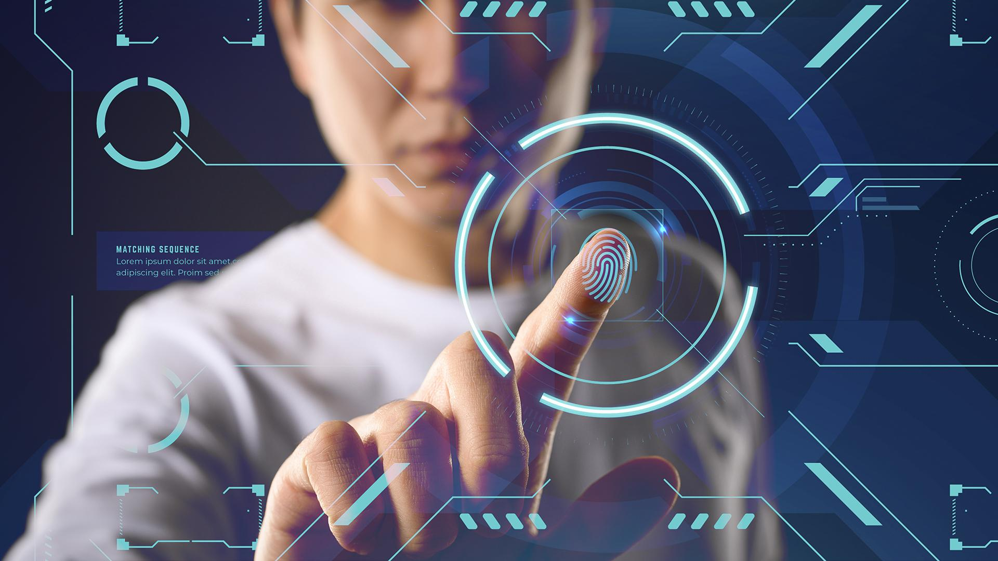
THANK YOU

